Slide 1
Linux
By vishal s. Pimple

Slide 2
Linux operating system
Linux is a Unix-like, open source and community-developed operating system (OS) for computers, servers, mainframes, mobile devices and embedded devices. It is supported on almost every major computer platform, including x86, ARM and SPARC, making it one of the most widely supported operating systems.

Slide 3
Linux Directory Commands
$pwd
$mkdir name
$rmdir name
$ls
$ls -l
$cd
$touch

Slide 4
Linux commands
$cat filename
$cat > filename
$head filename
$tail filename
$tac filename

Slide 5
commands
$hostname
$whoami
$ip addr
$clear
$cal
$ls -ltr

Slide 6
Grep command
"Global Regular Expression Print"
Grep command search for a particular
string/keyword from a file and print lines
matching a pattern.
It check line by line and print lines matching
given pattern.

Slide 7
$grep note file2
$grep –i note file2
$grep –w note file2
$grep –n text file1
$grep –e demo –e text

Slide 8
File Permission
r = read permission w = write permission x = execute permission
$chmod u+rwx
$chmod a+r
$chmod ugo+x
u | user/owner
g | group
o | other
a | all

Slide 9
File permissions with binary
421
rwx
$chmod 777 file1 : all permissions
$chmod 634 file2

Slide 10
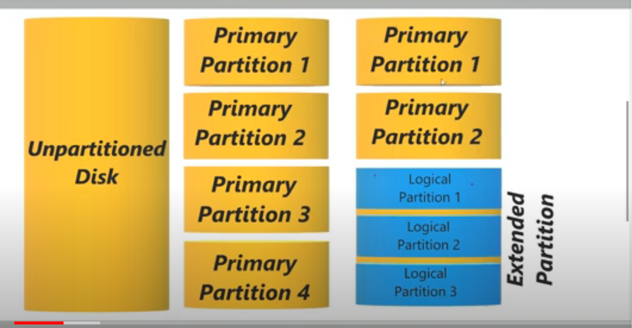
disk partitions

Slide 11
Partition commands
$lsblk
$fdisk –l /dev/xvdf
$fdisk /dev/xvdf
$ n : add new partition
$d : delete partition
$ p : for primary partition
$e : extended partition

Slide 12


